Slide 1
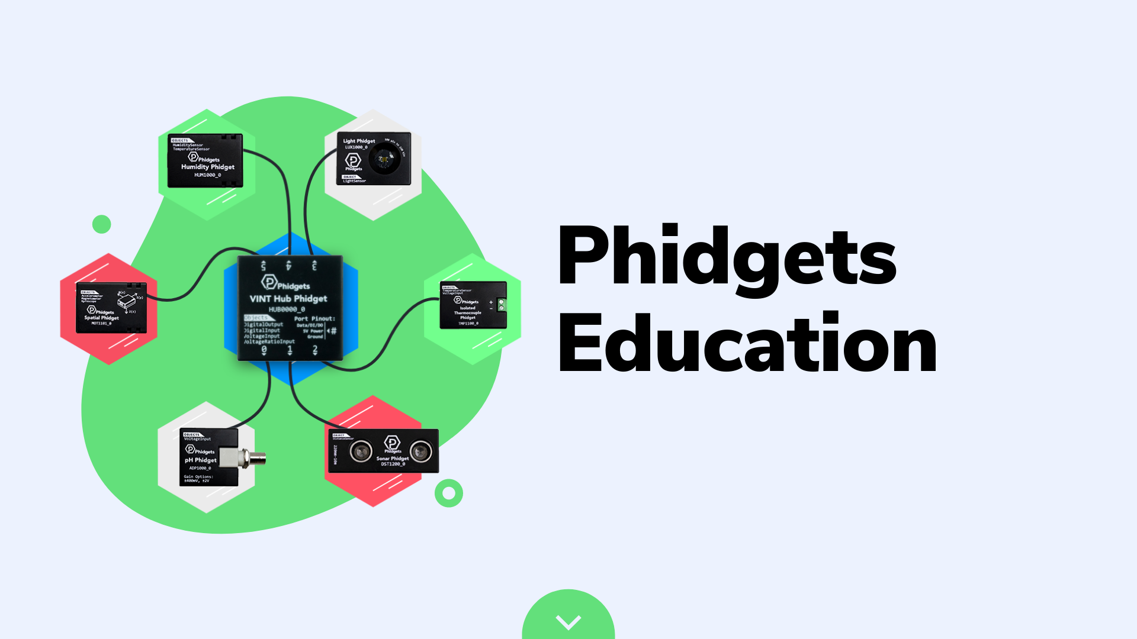
August 18, 2021
bit.ly/phidgets_webinar
Recommended Grades 9-12

Slide 3
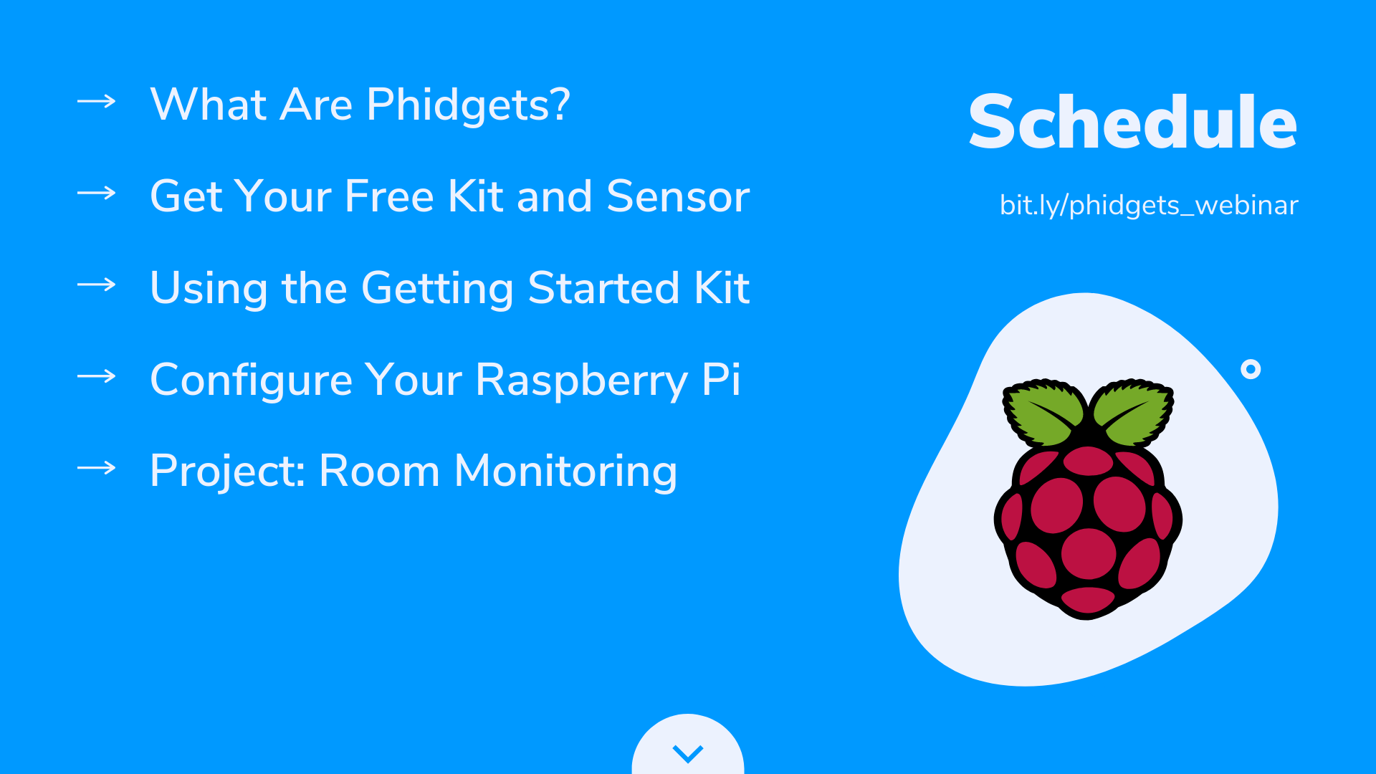

Slide 4
Programmable USB Sensors
Hundreds of Sensors
Windows, macOS, Raspberry Pi
Python, Java, C#, Swift
Used by STEM professionals for 20+ years

Slide 5
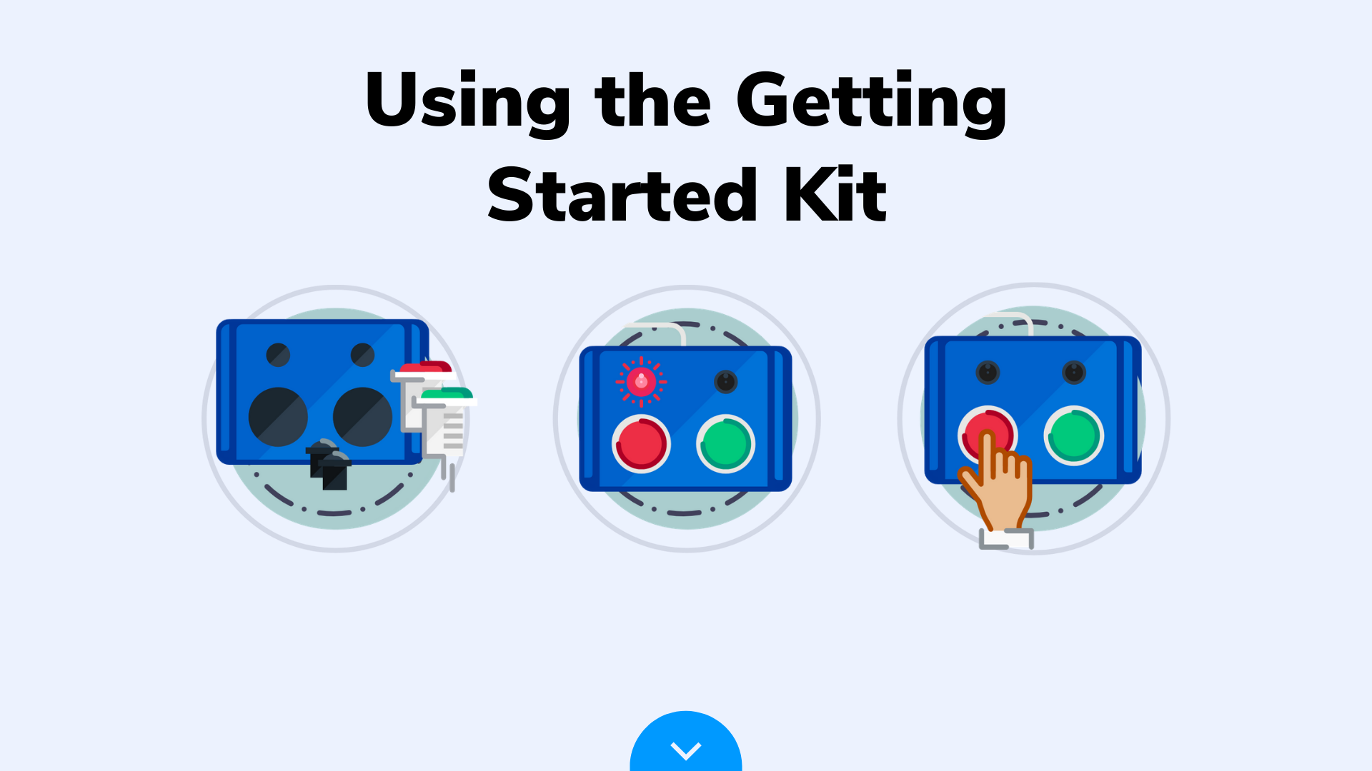
www.phidgets.com/start

Slide 6
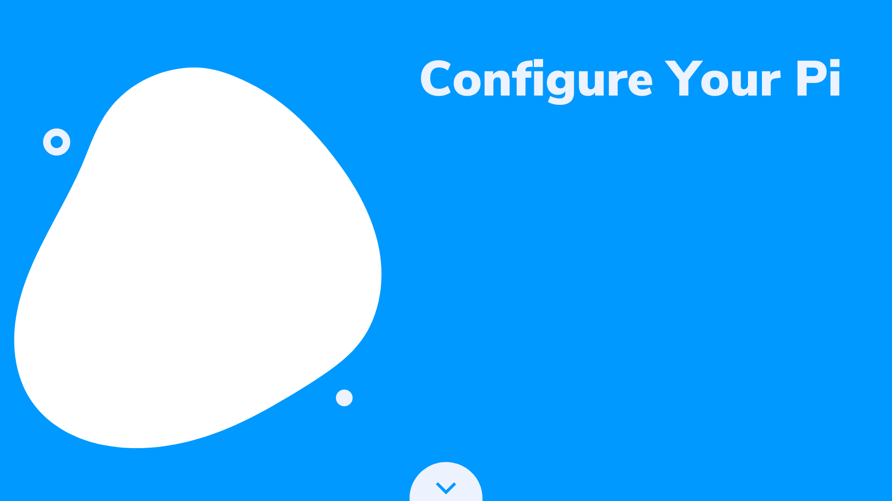
Extremely Simple!
All instructions are available in the Getting Started Kit under the “install” section
Open the terminal, enter the command below and you are done.
curl -fsSL https://www.phidgets.com/downloads/setup_linux | sudo -E bash -
sudo apt-get install -y libphidget22
www.phidgets.com/start

Slide 7
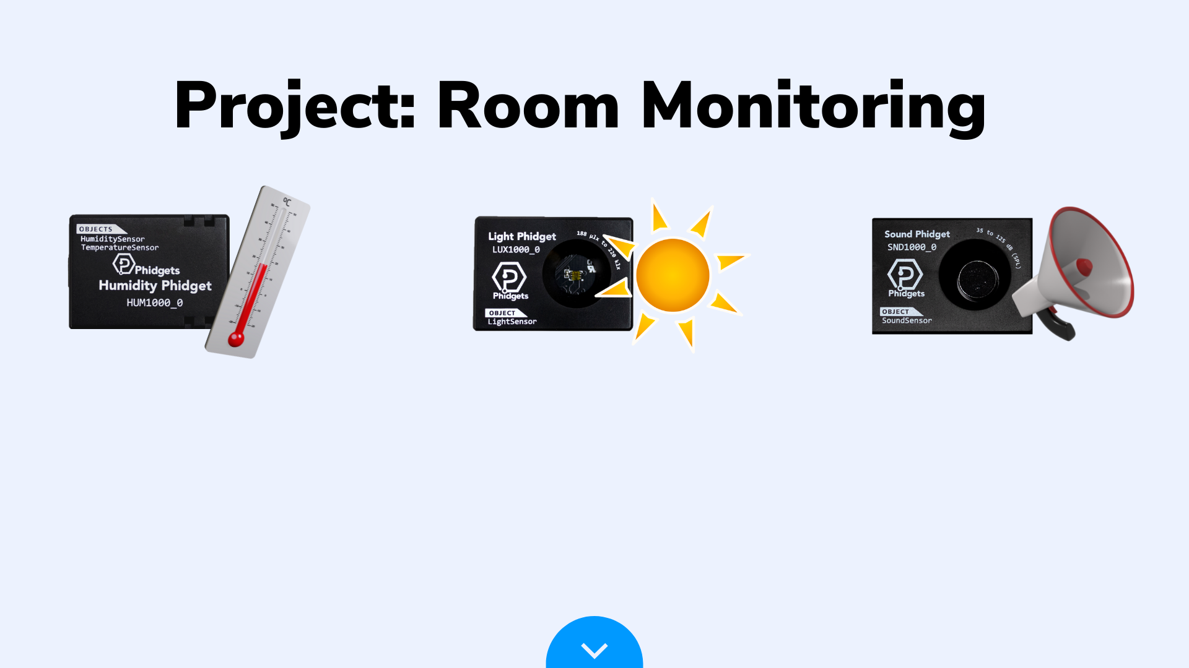
Goals For Today:
Measure temperature, humidity, light and sound.
Log the data to a file.
Configure the program to run on boot.

Slide 8
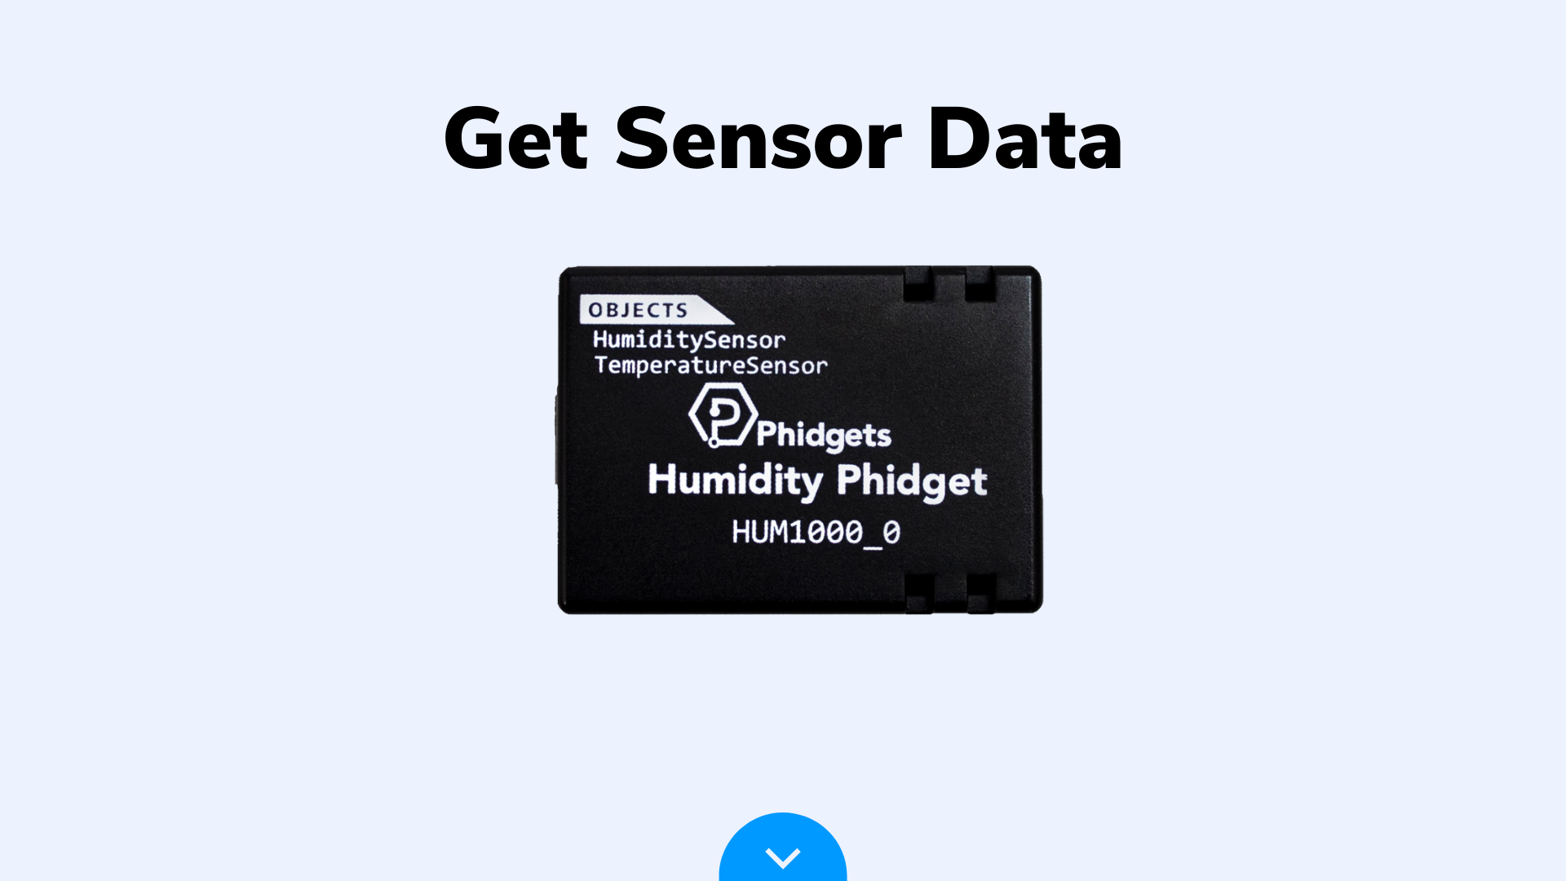
Device Tutorial Link

Slide 9
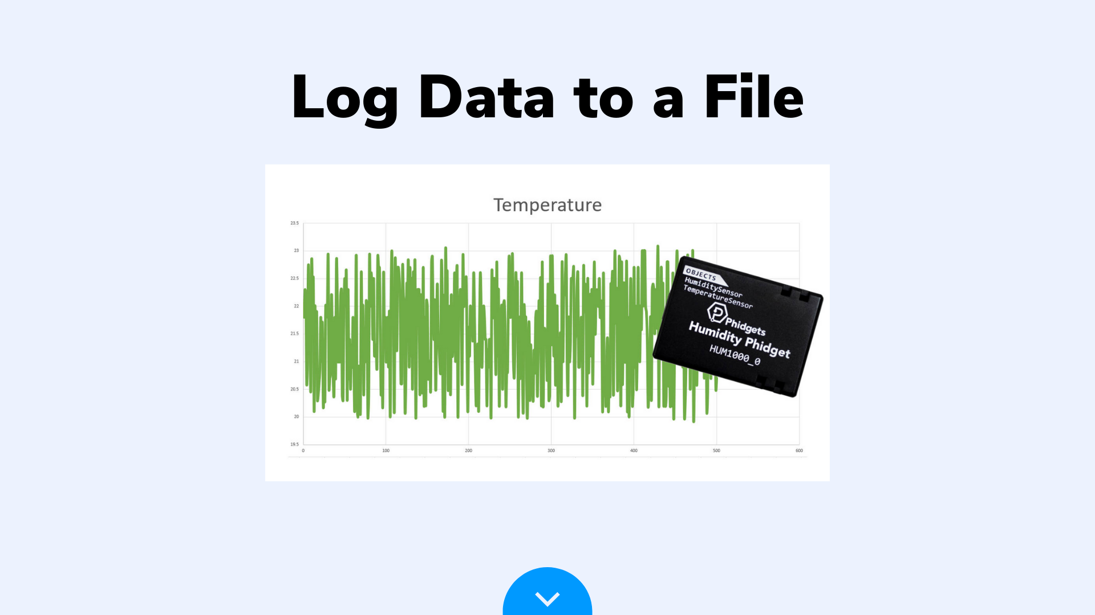
Project Link

Slide 10
Project Link

Slide 11
